Slide 1
AI-aided music composition system (長短期記憶神經網路於樂段生成之應用)
資工四 104590024 蔡一玄

Slide 2
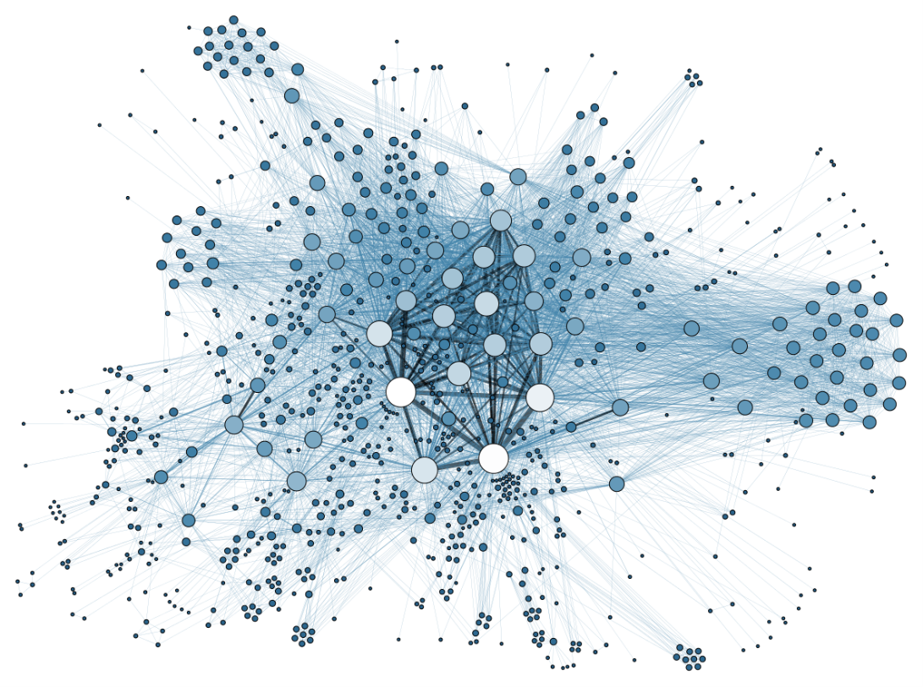

Motivation and Purpose
Getting started exploring machine learning
Knowing the limitation of computer’s creativity

Slide 3
System Structure and Procedure
Midi Files
Note Matrix
Probability Matrix
LSTM Neural Network Model
Output
Midi
Transform to
Feed to
Generate
Sampling

Slide 4


Details – Data Preprocessing and Transformation
Quantize all notes to 16th note
$\left[\begin{aligned}83 \\ 67 \\ 52 \\ 35\end{aligned}\right.\left.\begin{aligned}79 \\ 129 \\ 50 \\ 131\end{aligned}\right.\left.\begin{aligned}81 \\ 62 \\ 47 \\ 40\end{aligned}\begin{aligned} 128 \\ 129 \\ 52 \\ 38\end{aligned}\begin{aligned}73 \\ 65 \\ 130 \\ 131\end{aligned}\begin{aligned}128… \\ 70… \\ 130… \\ 39…\end{aligned}\right] \left[\begin{aligned}0 \\ 3 \\ 5 \\ 23\end{aligned}\right.\left.\begin{aligned}1 \\ 8 \\ 12 \\ 11\end{aligned}\right.\left.\begin{aligned}2 \\ 15 \\ 10 \\ 9\end{aligned}\begin{aligned}… \\ … \\ … \\ …\end{aligned}\right]$
Encode
Number of parts
{0:83, 1:79, 2:81
3:67, 4:73, 5:52}
t0 t1 t2 ．．．
Transpose
Time
[[ 1 0 0 1 0 1 0 0 0 0 0 0 0 0 0 0 0 0 0 0 0 0 0 1 …]
[ 0 1 0 0 0 0 0 0 1 0 0 1 1 0 0 0 0 0 0 0 0 0 0 0 …]
[ 0 0 1 0 0 0 0 0 0 1 1 0 0 0 0 1 0 0 0 0 0 0 0 0 …]
.
.
. ]
$$\left[\begin{aligned}0 \\ 1 \\ 2 \\ . \\ .\end{aligned}\right.\left. \begin{aligned}3 \\ 8 \\ 15 \\ . \\ .\end{aligned}\right.\left.\begin{aligned}5 \\ 12 \\ 10 \\ . \\ .\end{aligned}\begin{aligned} 23 \\ 11 \\ 9 \\ . \\ .\end{aligned}\right]$$
Input data(X) =
Transform
to
One-Hot
Representation
[ 1 0 0 1 0 1 0 0 0 0 0 0 0 0 0 0 0 0 0 0 0 0 0 1 …]

Slide 5
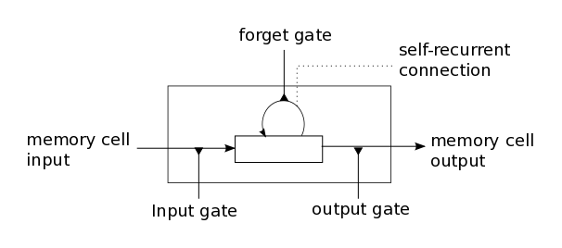
Details – Model Decision and Architecture
Choices : RNN, LSTM, GRU, RBM, CNN
First try : LSTM
1. Suitable for sequence or time-series data (Ex: speech recognition, translation)
2. Capable of learning long-term dependencies
(RNN has the problem: Vanishing/Exploding Gradients)
←LSTM Architecture

Slide 6
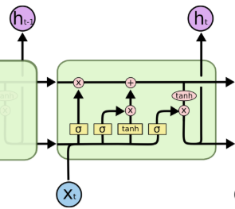
LSTM - Outline
Notation | Description
f , i , t | Forget gate, input gate, output gate
W_{f} , W_{i} , W_{o} , W_{c} U_{f} , U_{i} , U_{o} , U_{c}, V_{o} | Weight Matrices
f_{t} , i_{t} , o_{t} | Gates’ state at time t
b_{f} , b_{i} , b_{o} | Bias vectors
h_{t} | Hidden state at time t
x_{t} | Input value at time t
C_{t} | Cell state at time t
σ | Sigmoid function
Forget Gate
Output Gate
Input Gate

Slide 7





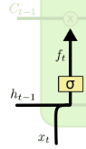
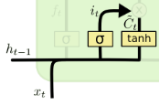
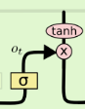
LSTM – Outline (Cont.)
h_{t-1}
h_{t}

Slide 8
Train Model
One bar notes
LSTM
Dropout
Dropout
LSTM
[[t0 ~ t16], …]
t0 = [ 1 0 0 1 0 1 0 0 0 0 0 0 0 0 0 0 0 0 0 0 0 0 0 1 …]
Output
Layer
Activation function
(Softmax)
Chord
Do
Re
Mi
…
Fa La

Slide 9
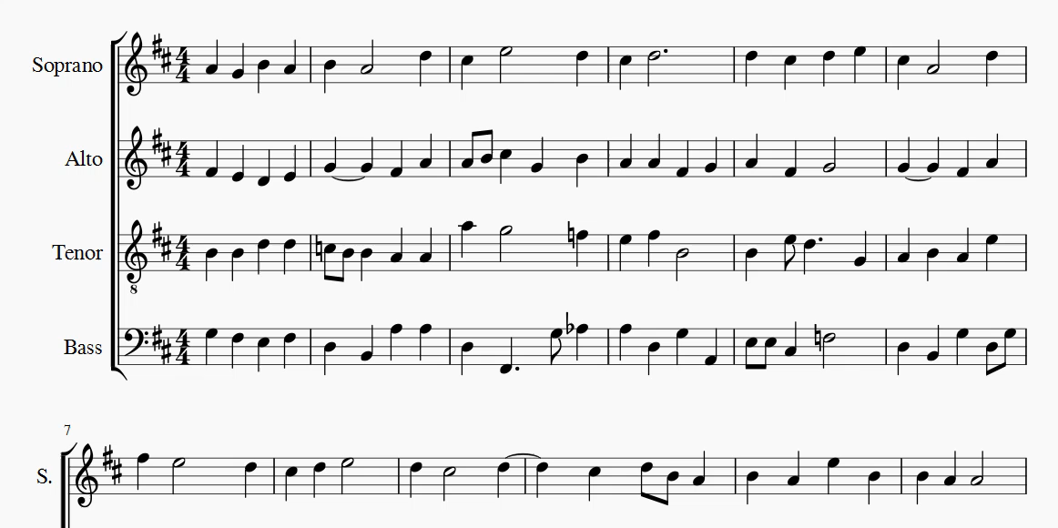
Results

